Slide 1
2.1 Arrays

Slide 2
Objectives
To define an array, initialize an array and refer to individual elements of an array.
To define symbolic constants.
To define and manipulate multiple-subscripted arrays.

Slide 3
Agenda
Introducing Arrays
Declaring Array Variables
Initializing Arrays
Accessing Array Elements
Copying Arrays

Slide 4
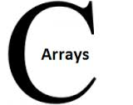
Introduction
An array is a collection of elements of the same type that are referenced by a common name.
Compared to the basic data type (int, float & char) it is an aggregate or derived data type.
All the elements of an array occupy a set of contiguous memory locations.
Why need to use array type? ….. Consider the following issue:
"We have a list of 1000 students' marks of an integer type. If using the basic data type (int), we will declare something like the following…"
int studMark0, studMark1, studMark2, ..., studMark999;

Slide 5
Introduction cont…
Declaration part by using normal variable declaration
int main(void)
{
int studMark1, studMark2, studMark3, studMark4, …, …, studMark998, stuMark999, studMark1000;
…
…
return 0;
}
By using an array, one can declare like this,
int studMark[1000];
This will reserve 1000 contiguous memory locations for storing the students’ marks.

Slide 6
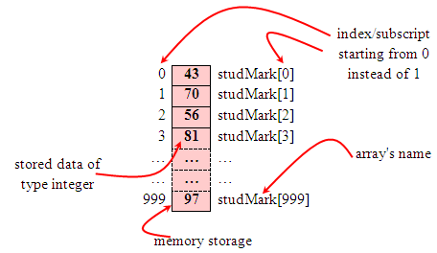
Introduction cont…
Graphically, this can be depicted as
So… array has simplified our declaration and of course, manipulation of the data.

Slide 7
One Dimensional Array: Declaration
Dimension refers to the array's size, which is how big the array is.
A single or one dimensional array declaration has the following form,
array_element_data_type array_name[array_size];
Here, array_element_data_type define the base type of the array, which is the type of each element in the array.
array_name is any valid C identifier name that obeys the same rule for the identifier naming.
array_size defines how many elements the array will hold.

Slide 8
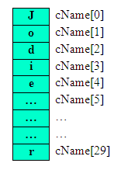
For example, to declare an array of 30 characters, that construct a people name, we could declare,
char cName[30];
In this statement, the array character can store up to 30 characters with the first character occupying location cName[0] and the last character occupying cName[29].
Note that the index runs from 0 to 29. In C, an index always starts from 0 and ends with array's (size-1).
So, take note the difference between the array size and subscript/index terms.

Slide 9
Examples of the one-dimensional array declarations,
int xNum[20], yNum[50];
float fPrice[10], fYield;
char chLetter[70];
The first example declares two arrays named xNum and yNum of type int. Array xNum can store up to 20 integer numbers while yNum can store up to 50 numbers.
The second line declares the array fPrice of type float. It can store up to 10 floating-point values.
fYield is basic variable which shows array type can be declared together with basic type provided the type is similar.
The third line declares the array chLetter of type char. It can store a string up to 69 characters.
Why 69 instead of 70? Remember, a string has a null terminating character (\0) at the end, so we must reserve for it.

Slide 10
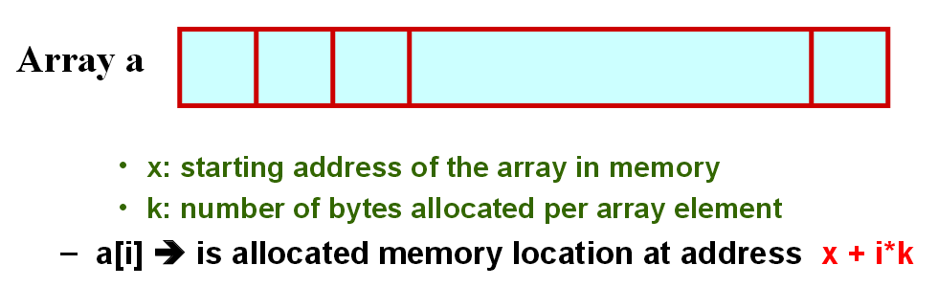
Starting from a given memory location, the successive array
elements are allocated space in consecutive memory locations.

Slide 11
One Dimensional Array: Initialization
Method 1--Initialization at the time of declaration
Giving initial values to an array.
Initialization of an array may take the following form,
type array_name[size] = {a_list_of_value};
For example:
int idNum[7] = {1, 2, 3, 4, 5, 6, 7};
float fFloatNum[5] = {5.6, 5.7, 5.8, 5.9, 6.1};
char chVowel[6] = {'a', 'e', 'i', 'o', 'u', '\0'};
The first line declares an integer array idNum and it immediately assigns the values 1, 2, 3, ..., 7 to idNum[0], idNum[1], idNum[2],..., idNum[6] respectively.
The second line assigns the values 5.6 to fFloatNum[0], 5.7 to fFloatNum[1], and so on.
Similarly the third line assigns the characters 'a' to chVowel[0], 'e' to chVowel[1], and so on. Note again, for characters we must use the single apostrophe/quote (') to enclose them.
Also, the last character in chVowel is NULL character ('\0').

Slide 12
Initialization of an array of type char for holding strings may take the following form,
char array_name[size] = "string_lateral_constant";
For example, the array chVowel in the previous example could have been written more compactly as follows,
char chVowel[6] = "aeiou";
When the value assigned to a character array is a string (which must be enclosed in double quotes), the compiler automatically supplies the NULL character but we still have to reserve one extra place for the NULL.
For unsized array (variable sized), we can declare as follow,
char chName[ ] = "Mr. Dracula";
C compiler automatically creates an array which is big enough to hold all the initializer.

Slide 13
Different cases: Initialization
To set every element to same value
int n[ 5 ] = { 0 };
If array size omitted, initializers determine size
int n[] = { 1, 2, 3, 4, 5 };
5 initializers, therefore 5 element array
int n[ 5 ] = { 1, 2, 3, 4, 5 };
If not enough initializers, rightmost elements 0
If too many syntax error

Slide 14
One Dimensional Array: Initialization
Method 2 – Set the values using loop
int main()
{ int n[ 10 ]; // n is an array of 10 integers
// initialize elements of array n to 0
for ( int i = 0; i < 10; i++ )
n[ i ] = 0; // set element at location i to 0
}

Slide 15
Array size
Can be specified with constant variable (const)
const int size = 20;
Constants cannot be changed
Constants must be initialized when declared
Also called named constants or read-only variables
The sizeof operator can determine the size of an
array (in bytes).
int a[10];
sizeof(a) = 40 (assuming each integer requires 4 bytes)

Slide 16
One Dimensional Array: Accessing array elements
Individual elements of the array can be accessed by using the array name followed by the element subscript enclosed in square brackets as follows:
array_name[subscript]
Notice that the array elements start from 0, not 1, so the first element of the a array is a[0] and the last element is a[size-1] where size is the number of element in the a array.
The following program demonstrates how to access elements of an array:
#include <stdio.h>
int main()
{
const int SIZE = 5;
int a[SIZE],i;
for(i = 0; i < SIZE; i++)
{ a[i] = i;
printf("a[%d] = %d\n",i,a[i]);
}
}

Slide 17
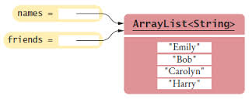
One Dimensional Array: Copying Arrays
Can you copy array using a syntax like this?
list = myList;
This is not allowed in C.
You have to copy individual elements from one array to the other as follows:
for (int i = 0; i < ARRAY_SIZE; i++)
{
list[i] = myList[i];
}

Slide 18

Rules to be followed when using arrays
The data type can be any valid data type such as int, float, char, etc. [structure or union – Will be dealt in later chapter].
All elements of an array must always be of the same data type
The name of an array must follow naming rules of variables.
The size of the array must be zero or a constant positive integer.
The array index must evaluate to an integer between 0 and n-1
where n is the number of elements in the array.

Slide 19
Don’t Do’s
You cannot
use = to assign one array variable to another
a = b; /* a and b are arrays */
use == to directly compare array variables
if (a = = b) ...........
directly scanf or printf arrays
printf (“......”, a);

Slide 20
Illustrations
Summing Elements in an array
Use a variable named total to store the sum. Initially total is 0. Add each element in the array to total using a loop like this:
double total = 0;
for (int i = 0; i < ARRAY_SIZE; i++)
{
total += myList[i];
}

Slide 21
Finding Maximum in an array
Use a variable named max to store the largest element. Initially max is myList[0]. To find the largest element in the array myList, compare each element in myList with max, update max if the element is greater than max.
double max = myList[0];
for (int i = 1; i < ARRAY_SIZE; i++)
{
if (myList[i] > max) max = myList[i];
}

Slide 22
Finding index of the largest element in the array
double max = myList[0];
int indexOfMax = 0;
for (int i = 1; i < ARRAY_SIZE; i++)
{
if (myList[i] > max)
{
max = myList[i];
indexOfMax = i;
}
}

Slide 23
Shifting Elements
double temp = myList[0]; // Retain the first element
// Shift elements left
for (int i = 1; i < myList.length; i++)
{
myList[i - 1] = myList[i];
}
// Move the first element to fill in the last position
myList[myList.length - 1] = temp;

Slide 24

Try it Yourself - Predict the output
1. #include <stdio.h>
int main()
{
int arr[5];
// Assume that base address of arr is 2000 and size of integer
// is 32 bit
arr++;
printf("%u", arr);
return 0;
}
2002
2004
2020
lvalue required

Slide 25
Try it Yourself - Predict the output
1. #include <stdio.h>
int main()
{
int arr[5];
// Assume that base address of arr is 2000 and size of integer
// is 32 bit
arr++;
printf("%u", arr);
return 0;
}
2002
2004
2020
lvalue required

Slide 26
Try it Yourself - Predict the output
2. What will be the output of the program ?
#include<stdio.h>
int main()
{ int a[5] = {5, 1, 15, 20, 25};
int i, j, m; i = ++a[1];
j = a[1]++; m = a[i++];
printf("%d, %d, %d", i, j, m);
return 0; }
A. 2, 1, 15
B. 1, 2, 5
C. 3, 2, 15
D. 2, 3, 20

Slide 27
Answers --- Predict the output
1. D) lvalue required
Array name in C is implemented by a constant pointer. It is not possible to apply increment and decrement on constant types.
2. C) 3, 2, 15
Step 1: int a[5] = {5, 1, 15, 20, 25}; The variable arr is declared as an integer array with a size of 5 and it is initialized to
a[0] = 5, a[1] = 1, a[2] = 15, a[3] = 20, a[4] = 25 .
Step 2: int i, j, m; The variable i,j,m are declared as an integer type.
Step 3: i = ++a[1]; becomes i = ++1; Hence i = 2 and a[1] = 2
Step 4: j = a[1]++; becomes j = 2++; Hence j = 2 and a[1] = 3.
Step 5: m = a[i++]; becomes m = a[2]; Hence m = 15 and i is incremented by 1(i++ means 2++ so i=3)
Step 6: printf("%d, %d, %d", i, j, m); It prints the value of the variables i, j, m
Hence the output of the program is 3, 2, 15
3. D) The program may print 0 five times followed by garbage value, or may crash if address (arr+5) is invalid.

Slide 28
Try it Yourself – Code debugging
#include <stdio.h>
#define MAXSIZE 10
void main()
{ int array[MAXSIZE];
int i, num, negative_sum = 0;
printf ("Enter the value of N \n");
scanf("%d", &num);
printf("Enter %d numbers \n", num);
for (i = 0; i < num; i++)
{ scanf("%d", array[i]); }
/* Summation starts */
for (i = 0; i < num; i++)
{ if (array[i] < 0) { negative_sum = negative_sum + array[i];
}
printf("\n Sum of all negative numbers = %d\n", negative_sum);
}

Slide 29
Answers – Code Debugging
#include <stdio.h>
#define MAXSIZE 10
void main()
{ int array[MAXSIZE];
int i, num, negative_sum = 0;
printf ("Enter the value of N \n");
scanf("%d", &num);
printf("Enter %d numbers \n", num);
for (i = 0; i < num; i++)
{
scanf("%d", &array[i]);
} /* Summation starts */
for (i = 0; i < num; i++)
{
if (array[i] < 0) { negative_sum = negative_sum + array[i];
}
printf("\n Sum of all negative numbers = %d\n", negative_sum);
}

Slide 30
Try it Yourself - Write a Program to…
Print the Alternate Elements in an Array
Find 2 Elements in the Array such that Difference between them is Largest
Sort the Array in an Ascending Order
Search the element using
Linear search
Binary search
Sort the array of elements using
Selection sort
Bubble Sort
Insertion Sort

